Slide 1
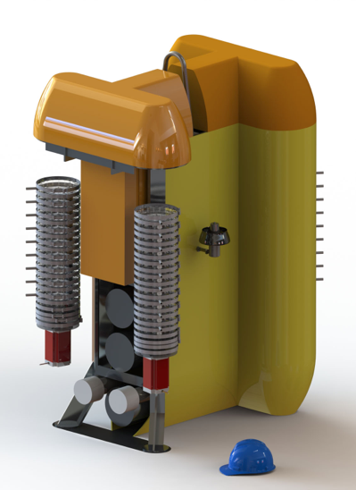
Fully Autonomous Particle Profiling: Clio Chip Breier UTRGV
Designed to enable next generation ocean sectional studies of marine genomics, proteomics, metabolimics, as well as trace metals.
Vertical AUV with the sole purpose of conducting geochemical sampling and sensing
Trace metal clean, 6000m depth rated
Can support up to 4 in situ pumping systems each capable of collecting up to 18 samples per deployment
Can support standard and experimental sensors
Complement or alternative to traditional wire based sample collection.
Image M. Jakuba
NSF funded, Chip Breier, Jakuba, Dick, Saito
Clio questions: John.Breier@utrgv.edu

Slide 2
Clio Operations
Image M. Jakuba
Clio deployments designed around a nominal 14 hour deployment schedule during which 16 sample sets are collected at depth stations down to 6000m.
Clio’s engineering sea trials are scheduled for July on R/V Armstrong.
Clio questions: John.Breier@utrgv.edu

Slide 3
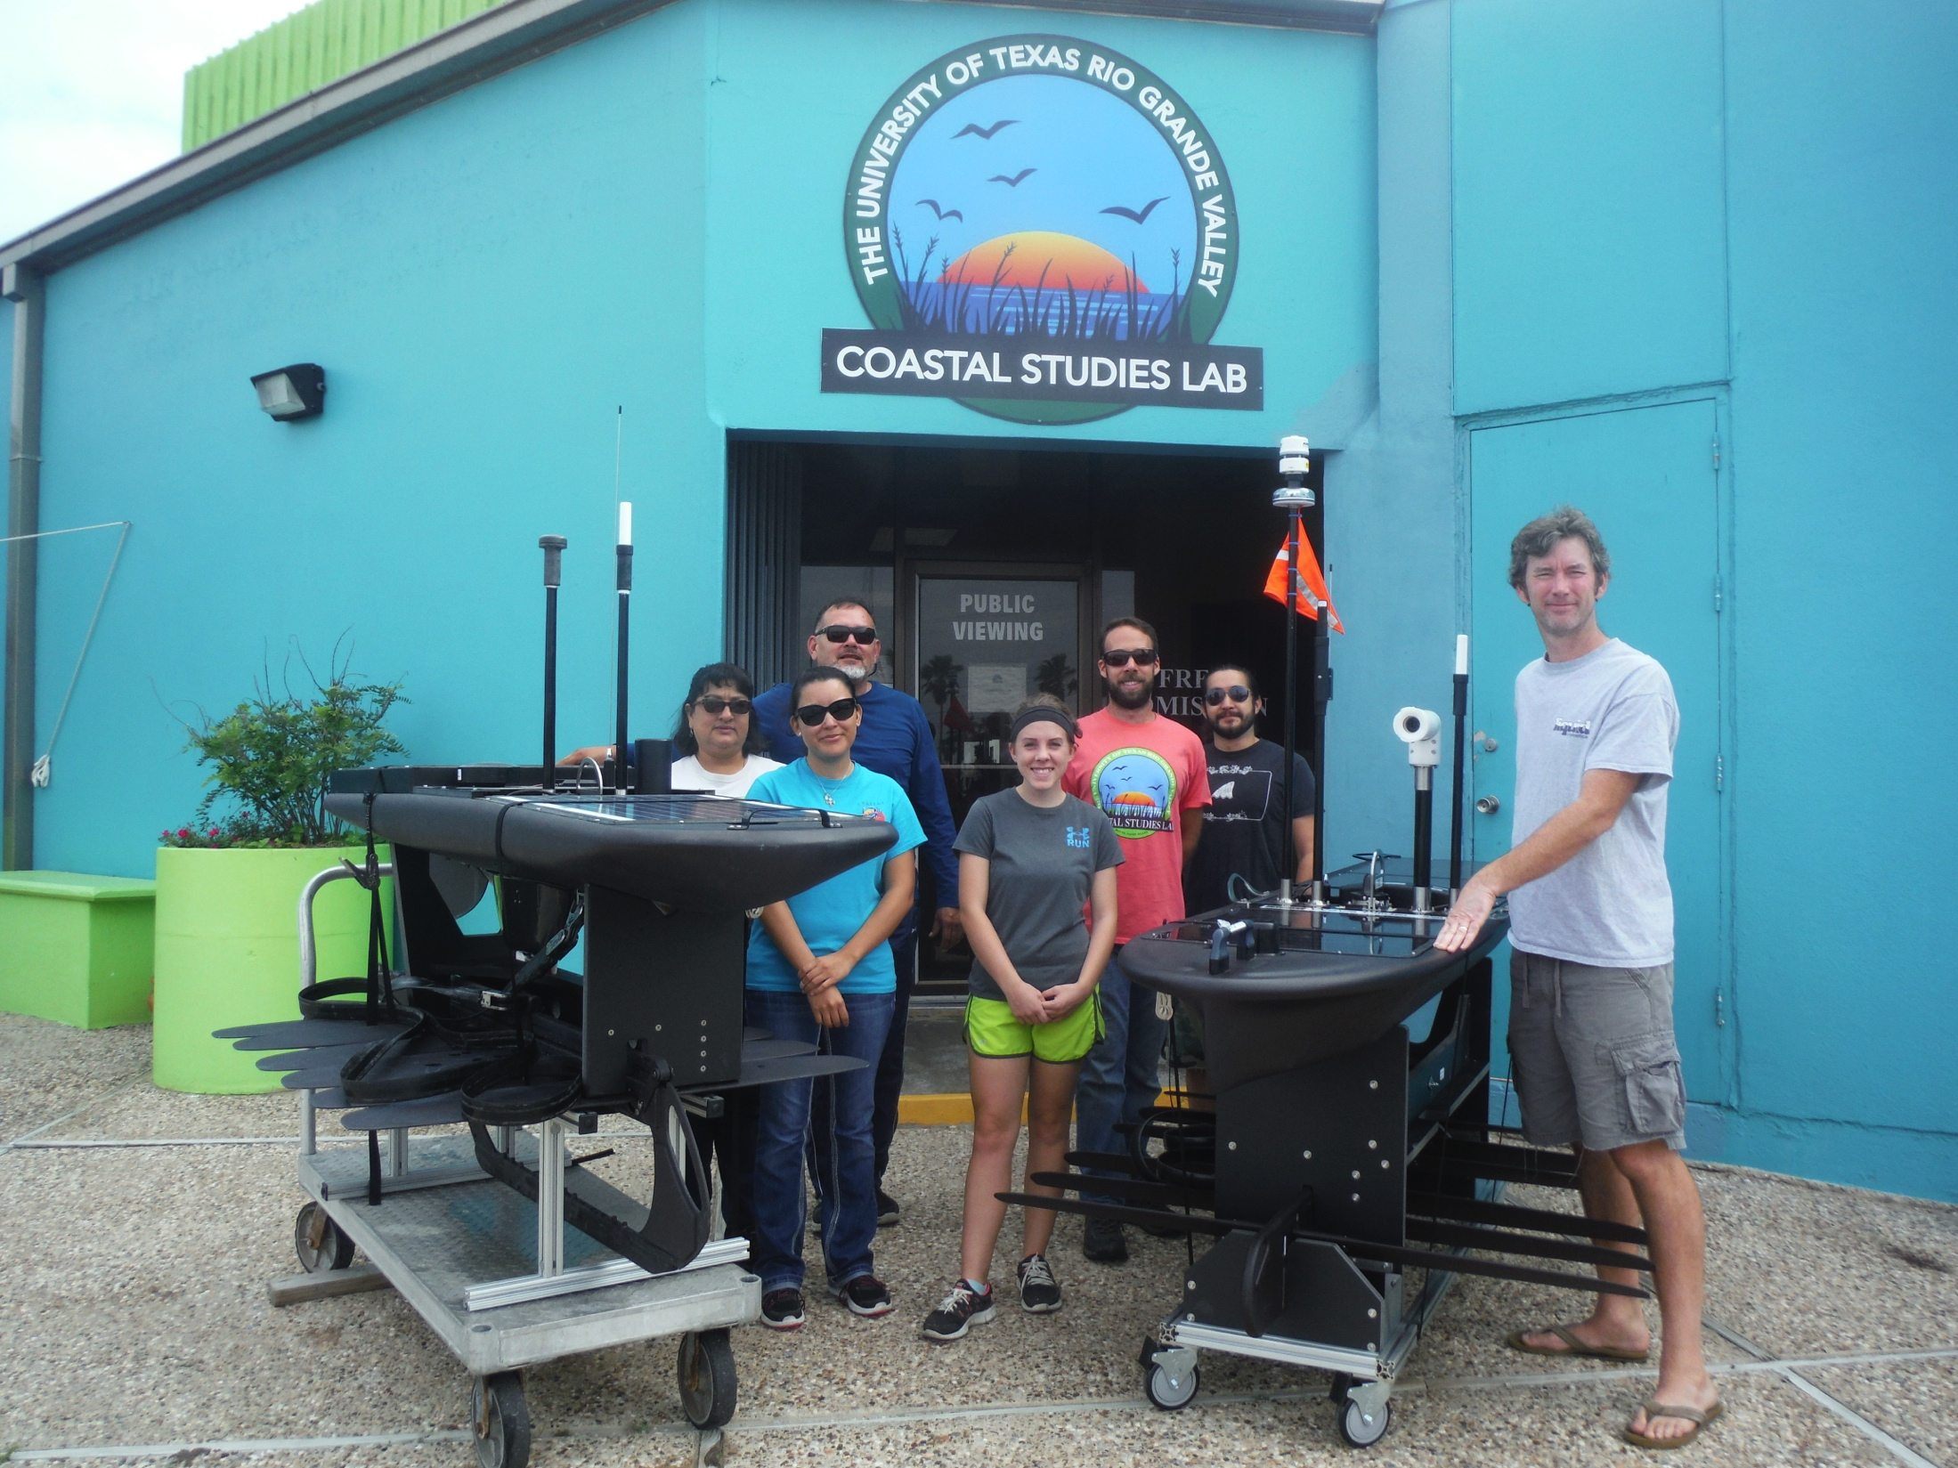
Working to Adapt Clio Technology to WaveGliders

