Slide 1
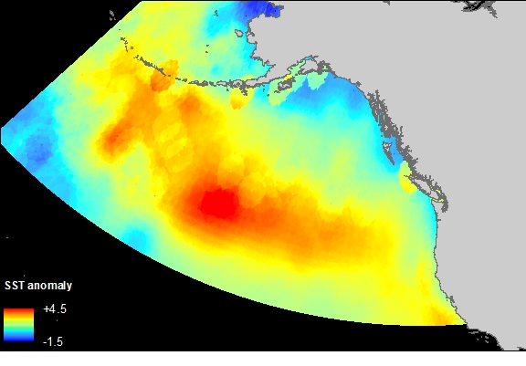
In Hot Water: Elephant Seals and the Blob
Rachel Holser
September 18, 2016
Ecology and Evolutionary Biology, UCSC
Notes:
I’m Rachel Holser, I’m starting the third year of my PhD in Daniel Costa’s lab. I have a Masters’ Degree in Oceanography from Oregon State University.
Thank Steve and Rebecca Sooy Fellowship

Slide 2
Notes:
The Blob, a large mass of unusually warm water in the NE Pacific, as we can see in the image from July 2015.
Whether we knew it or not, many of us have seen the impact this phenomenon first hand. By-the-wind-sailors washed up in droves along the beach here in California

Slide 3
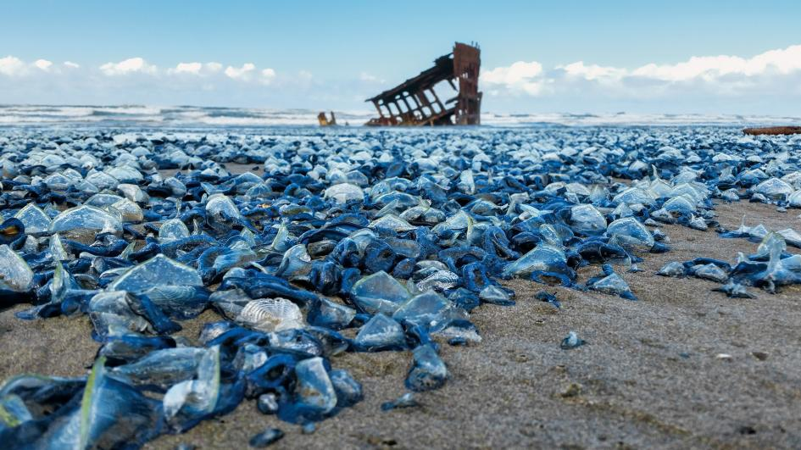
‘The Blob’ invades Pacific, flummoxing climate experts
Kintisch, Science
The warm blob continues to dominate the
ecosystem of the northern California current
Peterson, et al. PICES
Multi-year persistence of the 2014/15
North Pacific marine heatwave
Di Lorenzo and Mantua, Nature Climate Change
An unprecedented coastwide toxic algal bloom
linked to anomalous ocean conditions
McCabe, et al. Geophysical Research Letters
Causes and impacts of the 2014
warm anomaly in the NE Pacific
Bond, et al. Geophysical Research Letters
Nudibranch range shifts associated with the 2014
warm anomaly in the Northeast Pacific
Goddard, et al. Southern California Academy of Sciences
Photo: Paul Nicklen, National Geographic
Notes:
The scientific community immediately got to work trying to understand the cause of the strange mass of warm water and how it might be affecting North Pacific ecosystems.
One of the reasons the Blob is so compelling (and worrisome) is that it may be a window into future conditions in the North Pacific as global temperatures continue to rise, including possible affects on top predators.

Slide 4
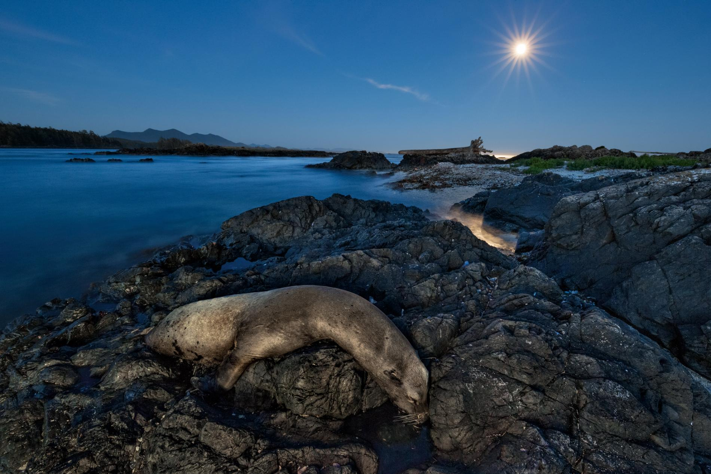
Photo: Paul Nicklen, National Geographic
Notes:
This image, the opener for an article in September’s National Geographic entitled The Blob That Cooked the Pacific, gives a harrowing illustration of the impact dramatic shifts in water temperature can have.

Slide 5
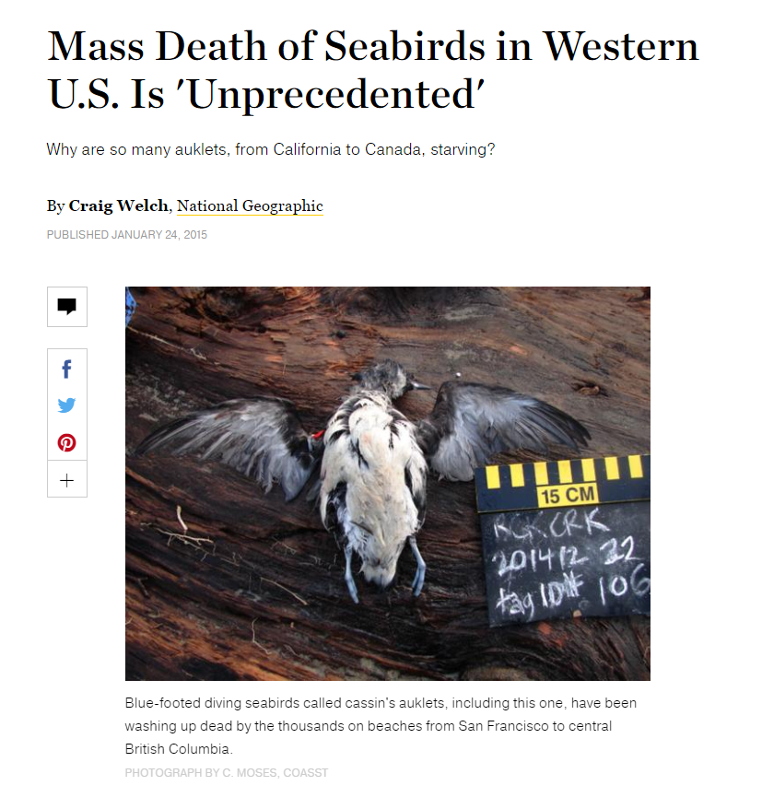
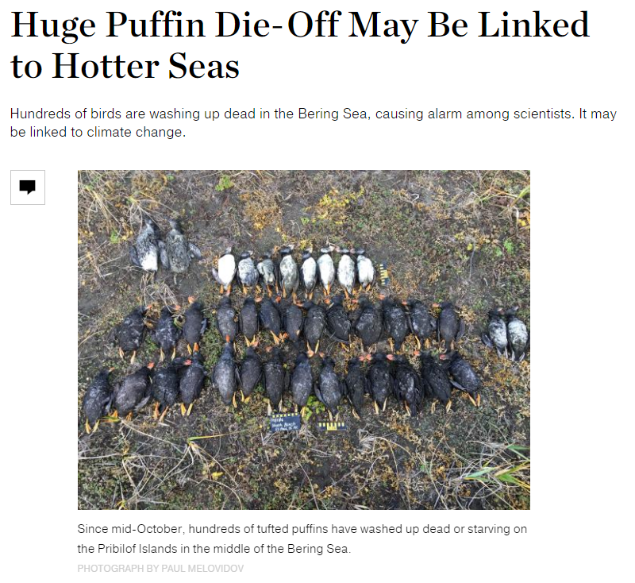
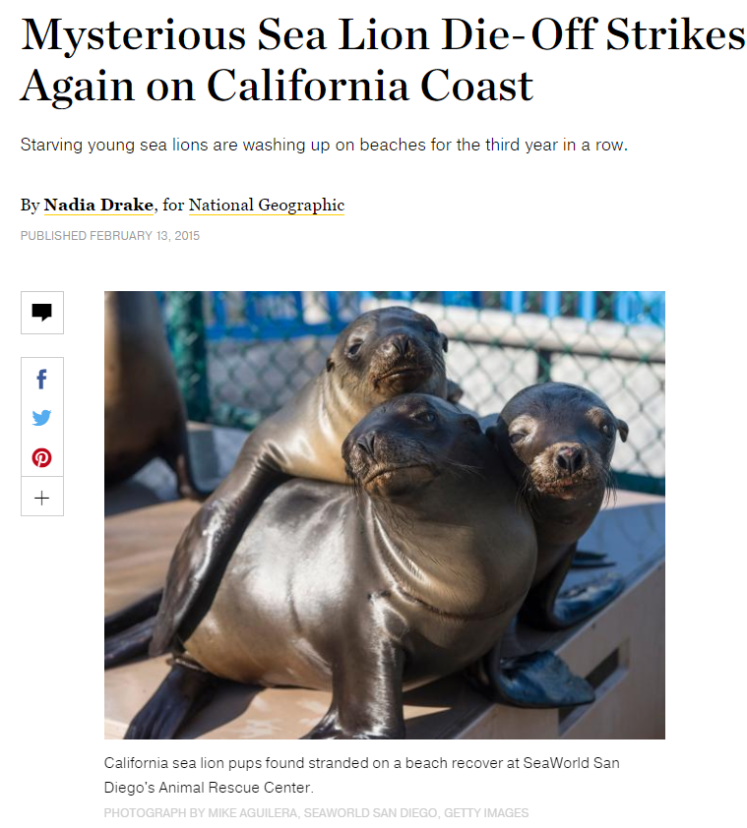
Notes:
Sharting in December of 2014, there have been a string of unusual die-offs. I was on the Oregon Coast with my family when thousands of cassin’s auklets began to wash ashore in front of our house. California sea lions stranded in huge numbers throughout that winter. Just a few weeks ago a puffin die-off started in the Bering Sea.

Slide 6
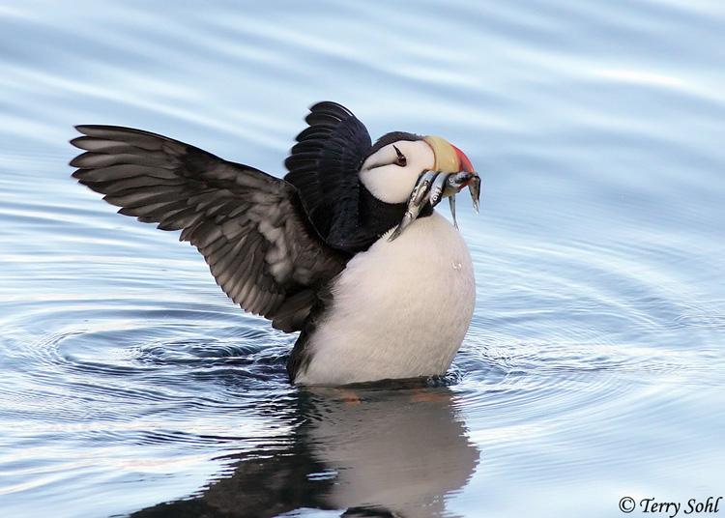
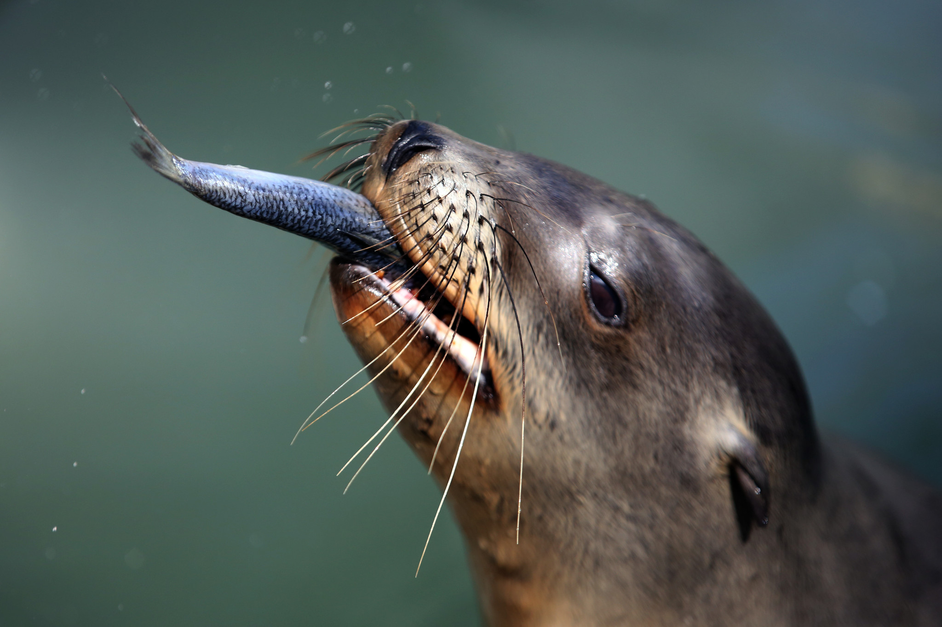
Photo: Irfan Khan, LA Times
Notes:
When the conditions change, so does primary production. Changes in productivity can ripple through the food web, sometimes with severe consequences for top predators.

Slide 7
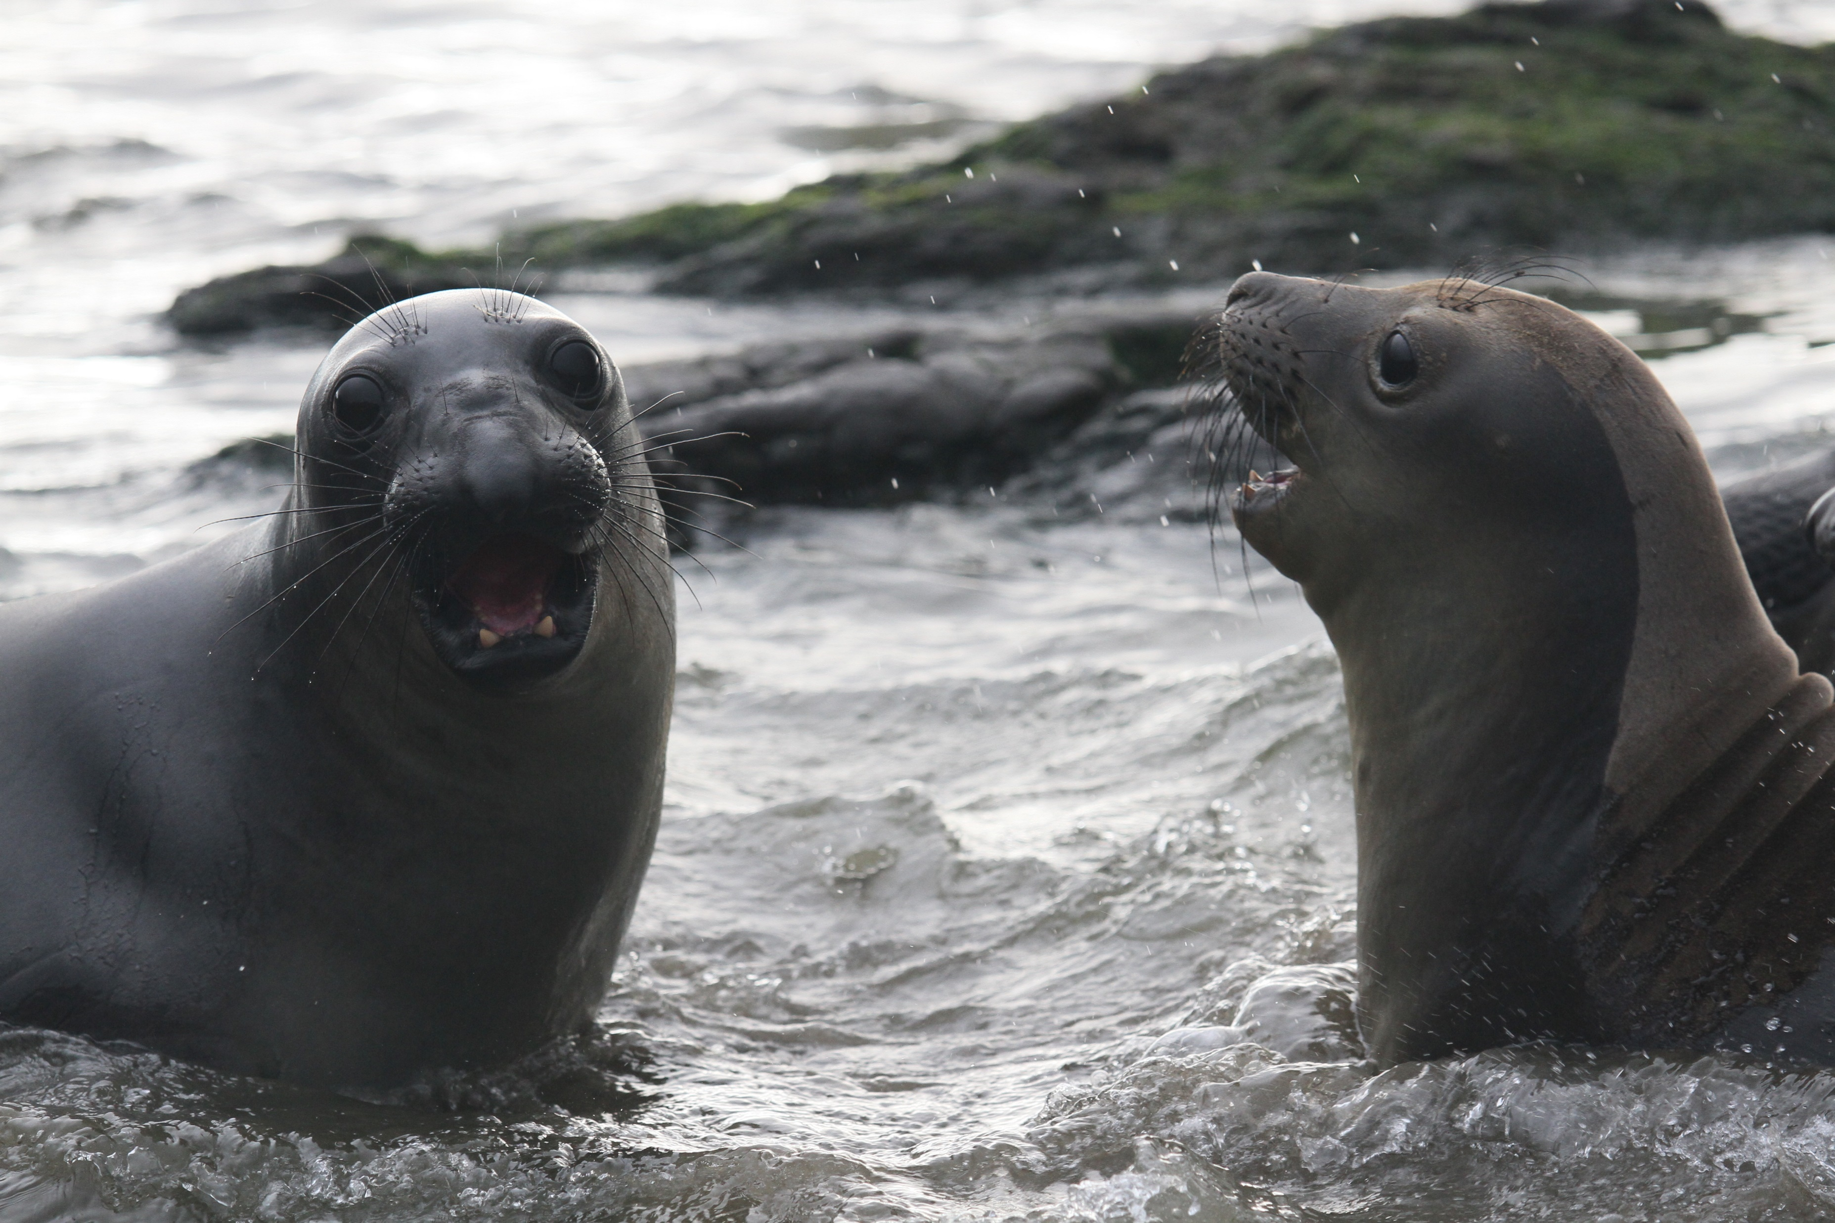
Photo: Rachel Holser
Notes:
I’d like to do a quick introduction to the northern elephant seal. This species spends the majority of its life at sea, coming to land briefly to breed and again to molt. The colony at Ano Nuevo is just 20 miles north of here, and The Costa Lab and its predecessors have been studying that population for over 40 years

Slide 8
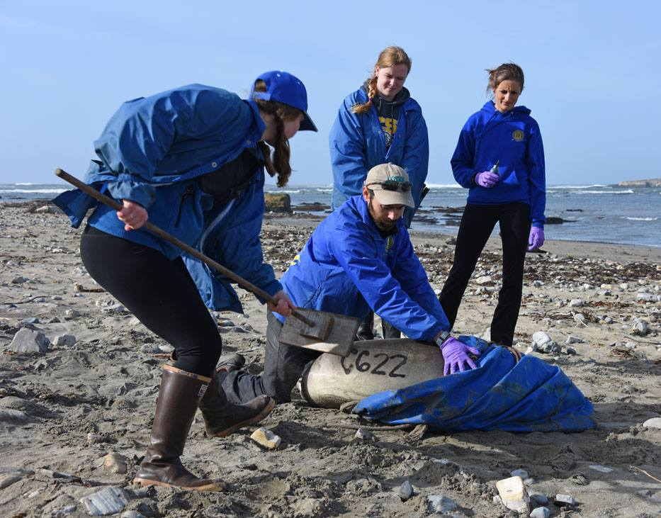
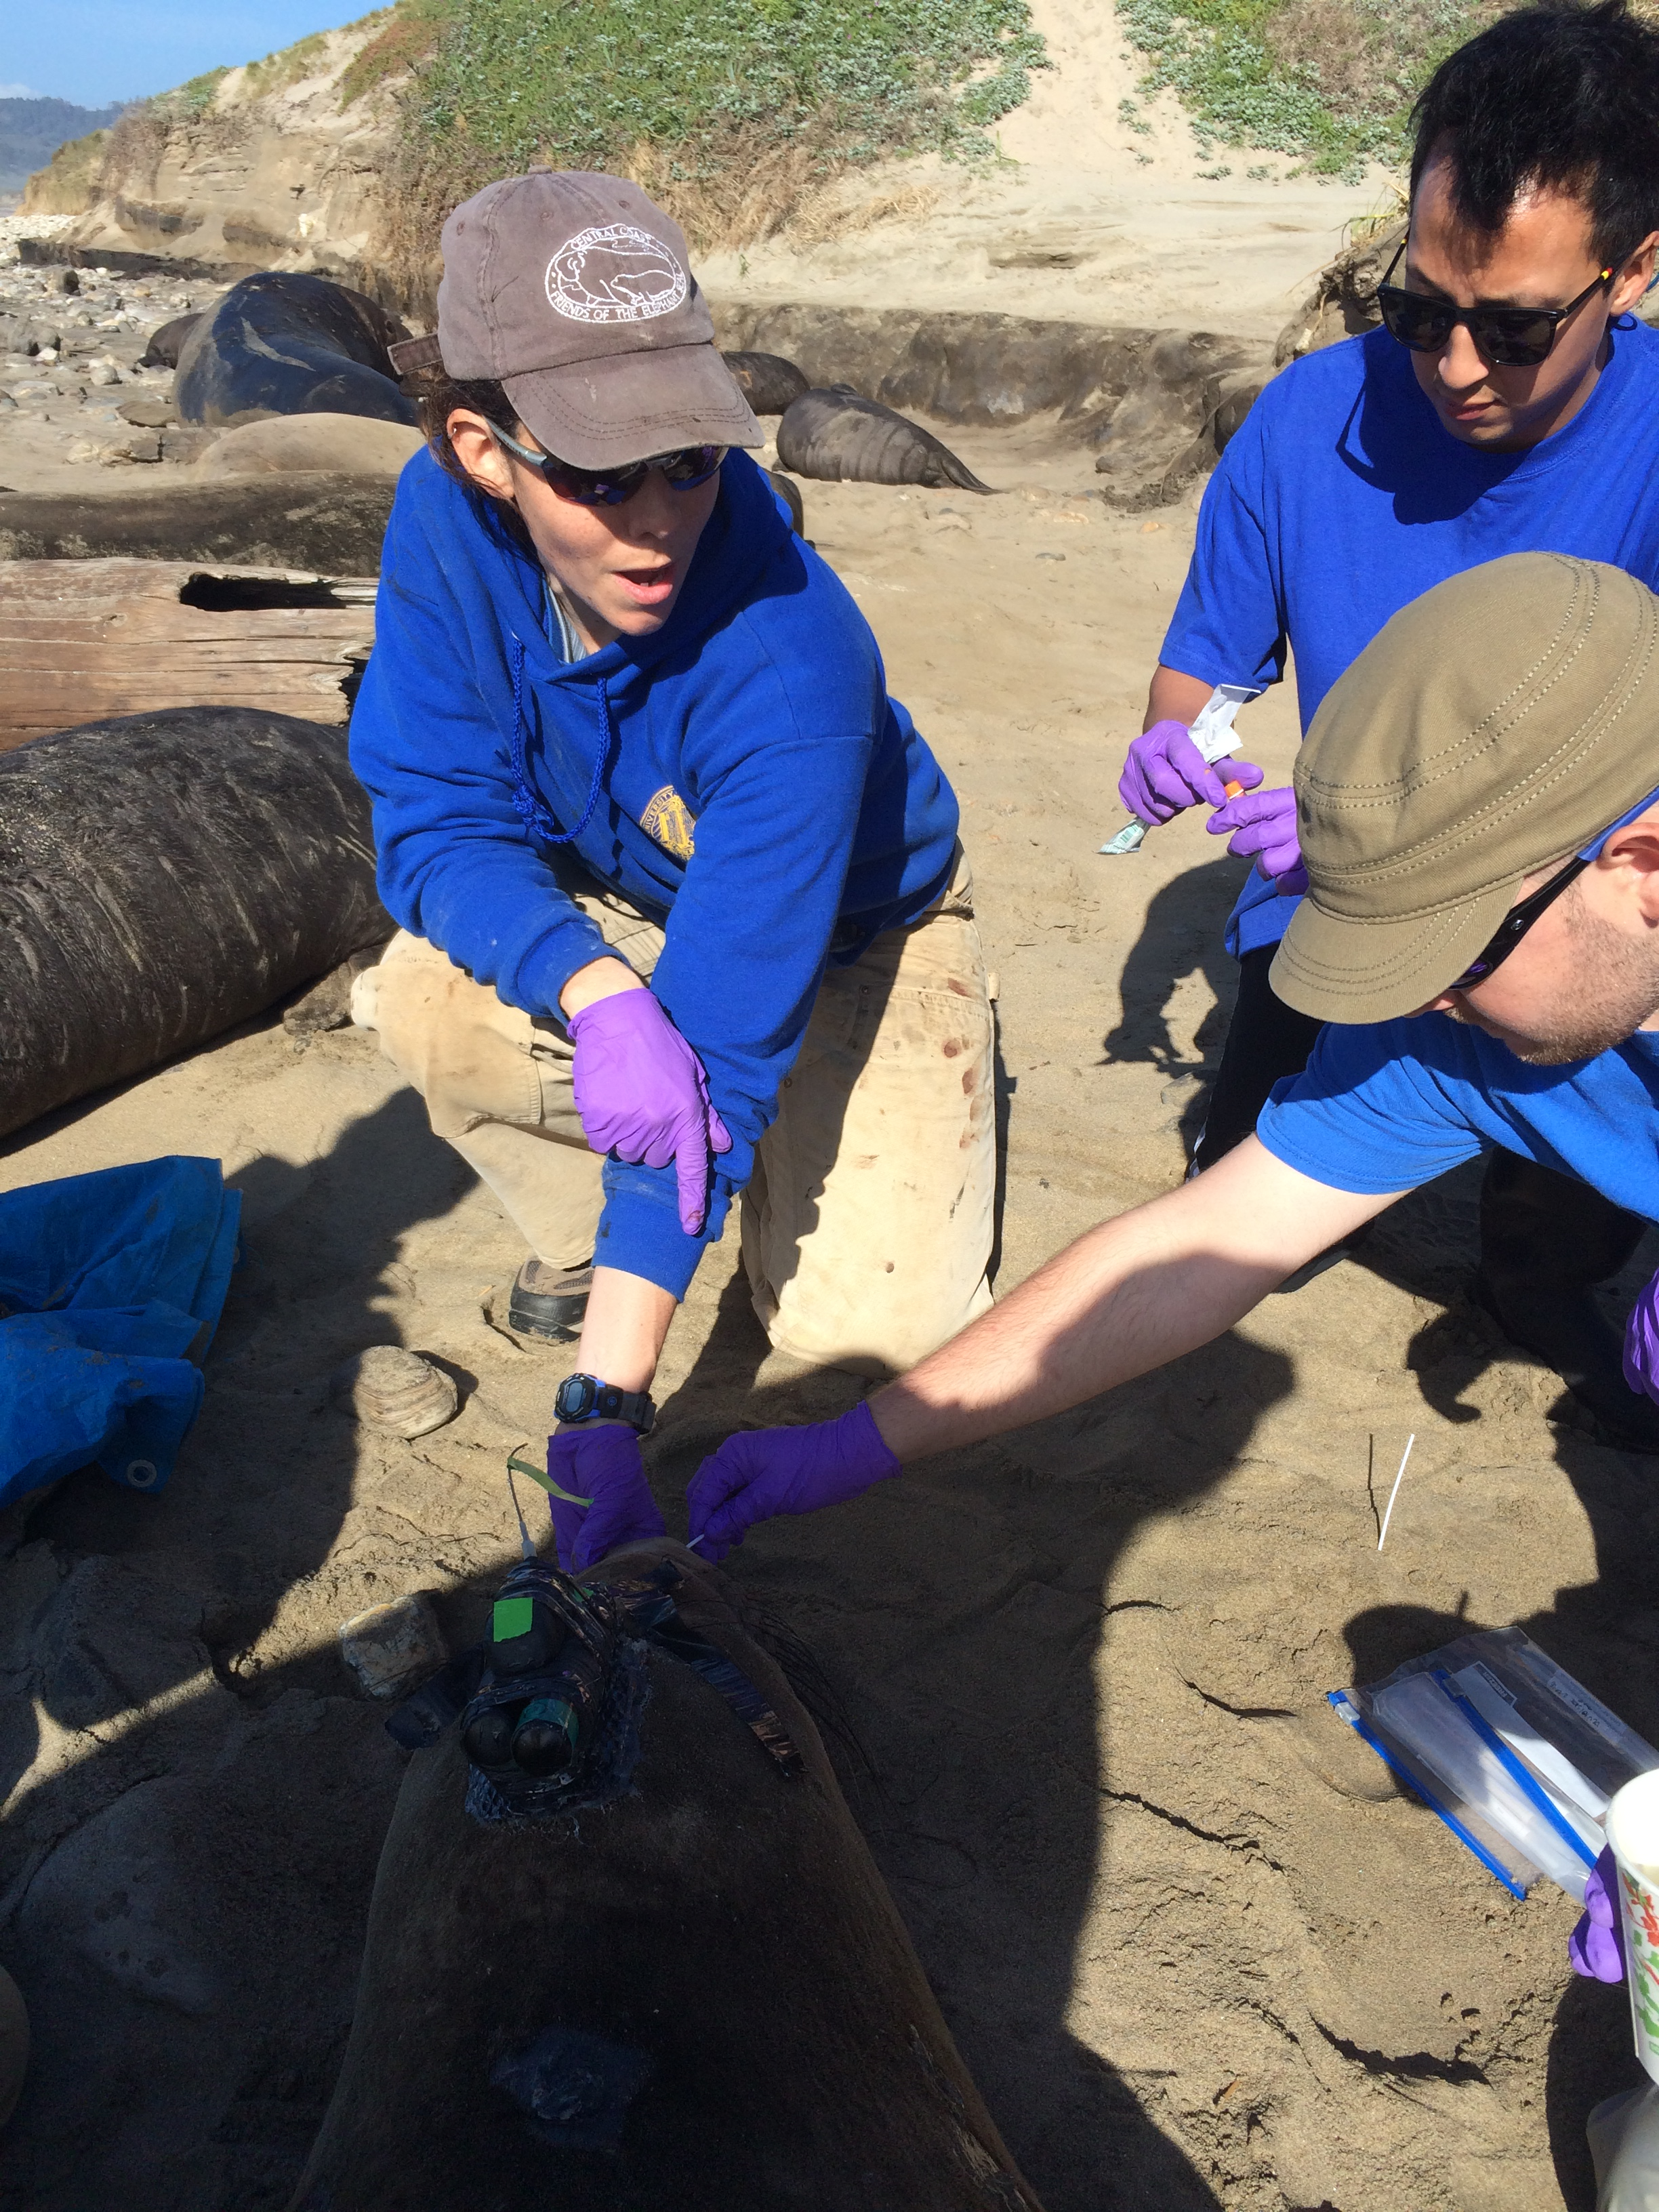
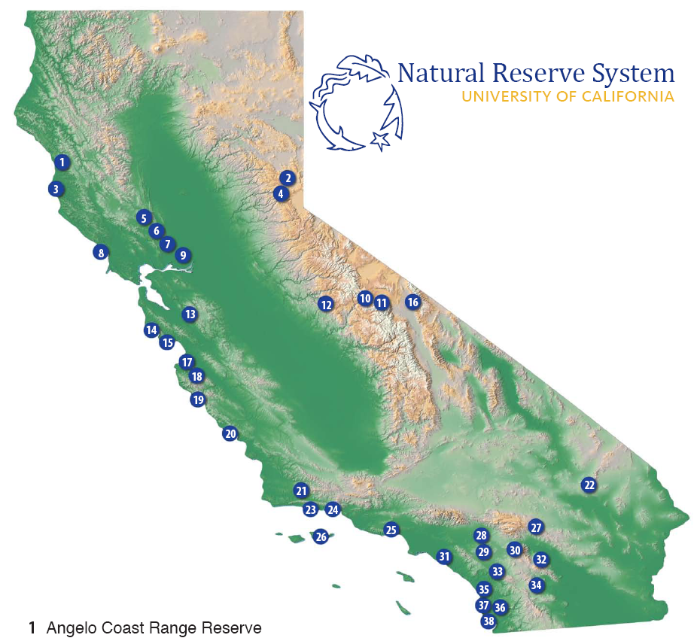
Photo: Patrick Robinson
Photo: Rachel Holser
Notes:
Año Nuevo is now part of the UC Natural Reserve system and undergraduates have the unique opportunity to participate in a lot field work that we do, particularly under the guidance of the reserve manager, Patrick Robinson, a former Costa student.

Slide 9
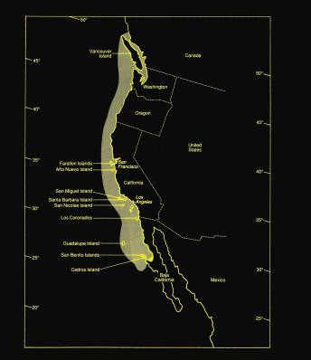
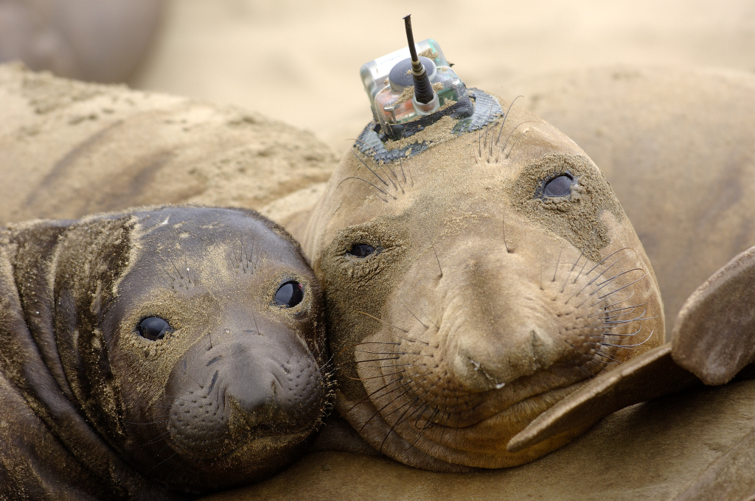
Visual Surveys
Riedman 1990
Photo: J Bradley
Notes:
We have been tracking seals for nearly two decades.

Slide 10
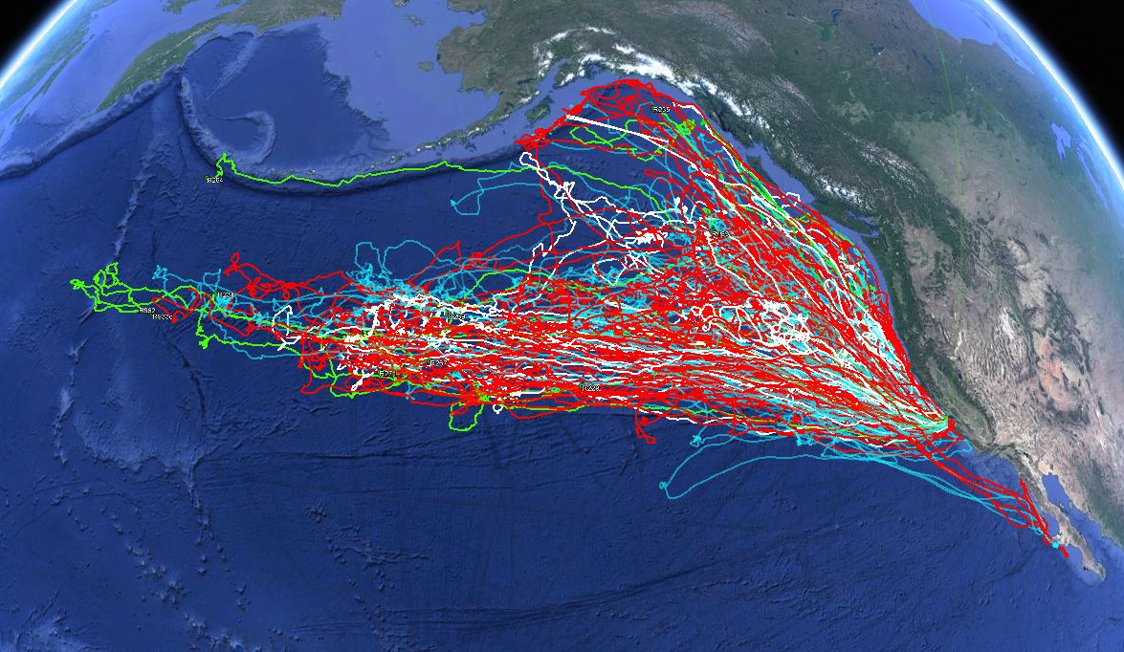
Notes:
I just have to point out that the tracks in green are this year’s seals, and one of those girls was named in honor of Phyllis Sooy. Phyllis has been making headlines because she swam further west than any seal we’ve tracked before.

Slide 11
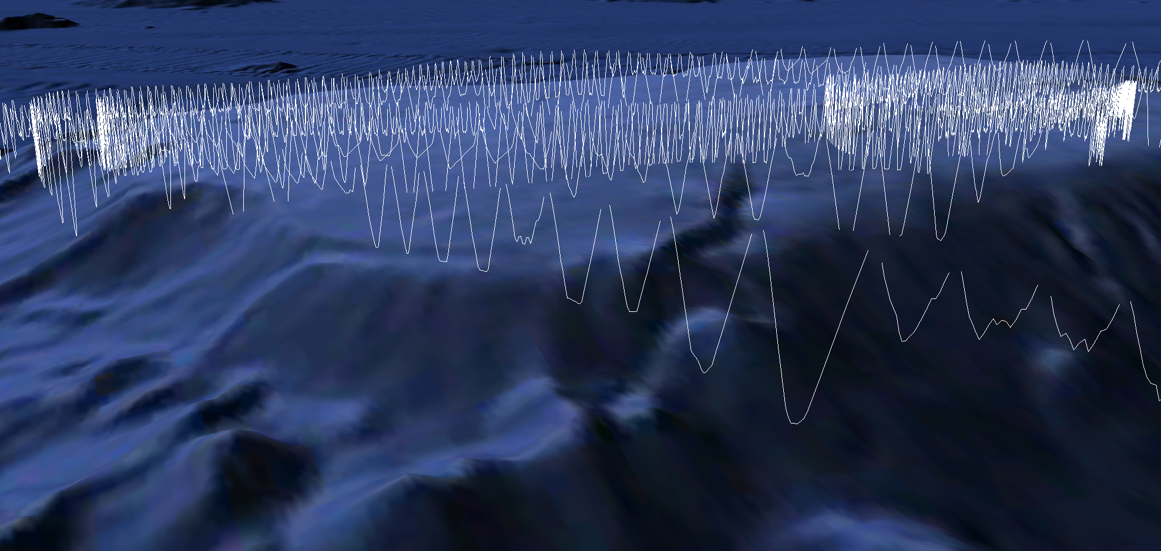
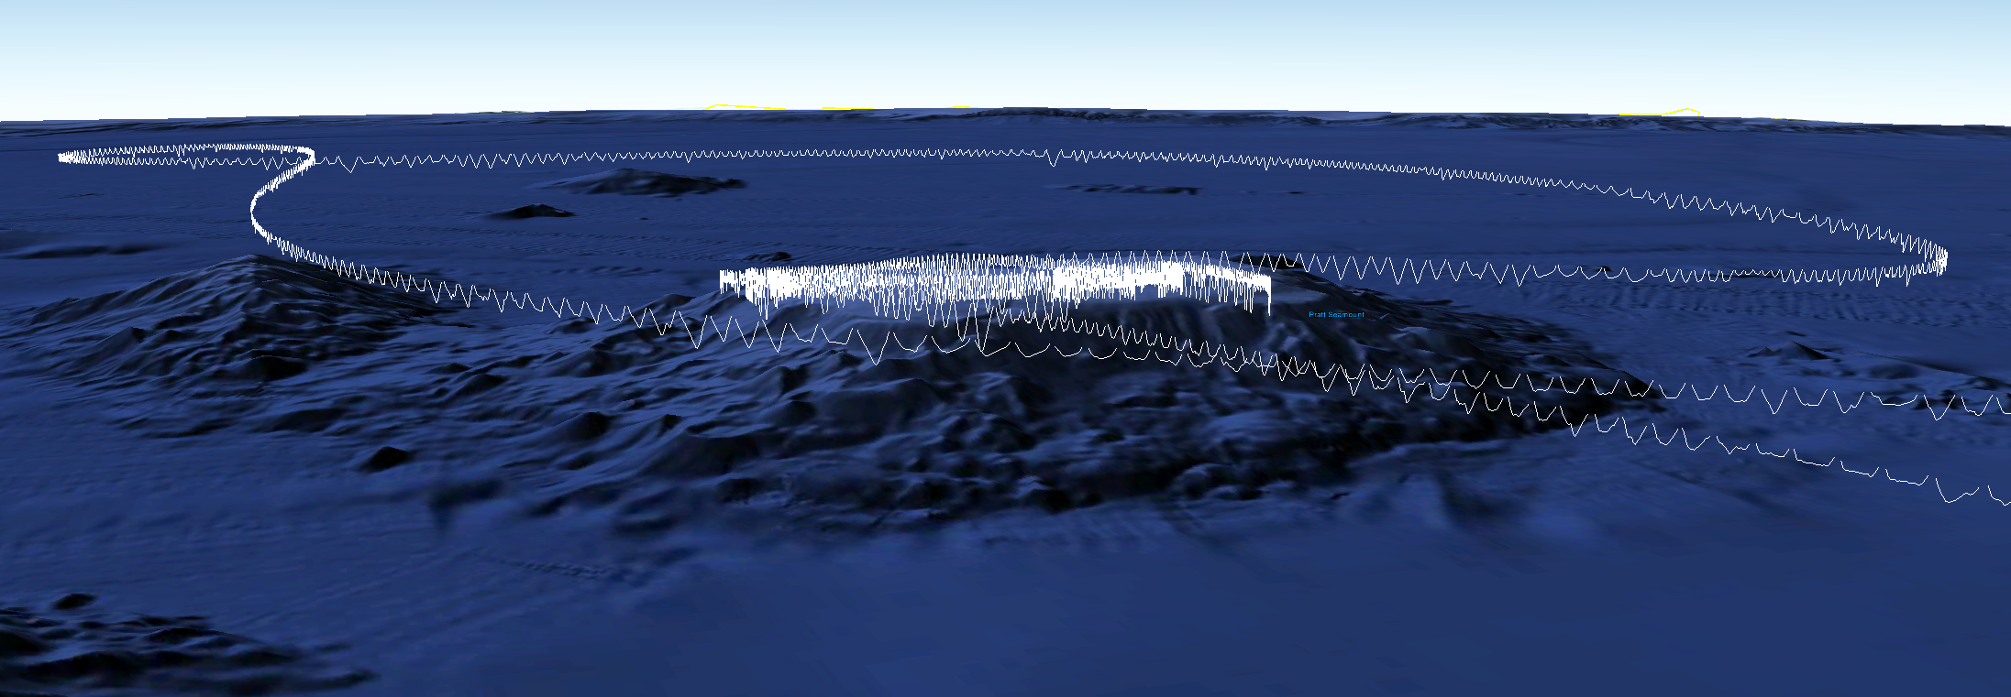
Notes:
We’ve also learned that elephant seals are continuously diving to great depths when they’re at sea – regularly below 800m and sometimes up to 1700m deep
This make them an extraordinary platform for learning about what is happening in the deep, open ocean.

Slide 12
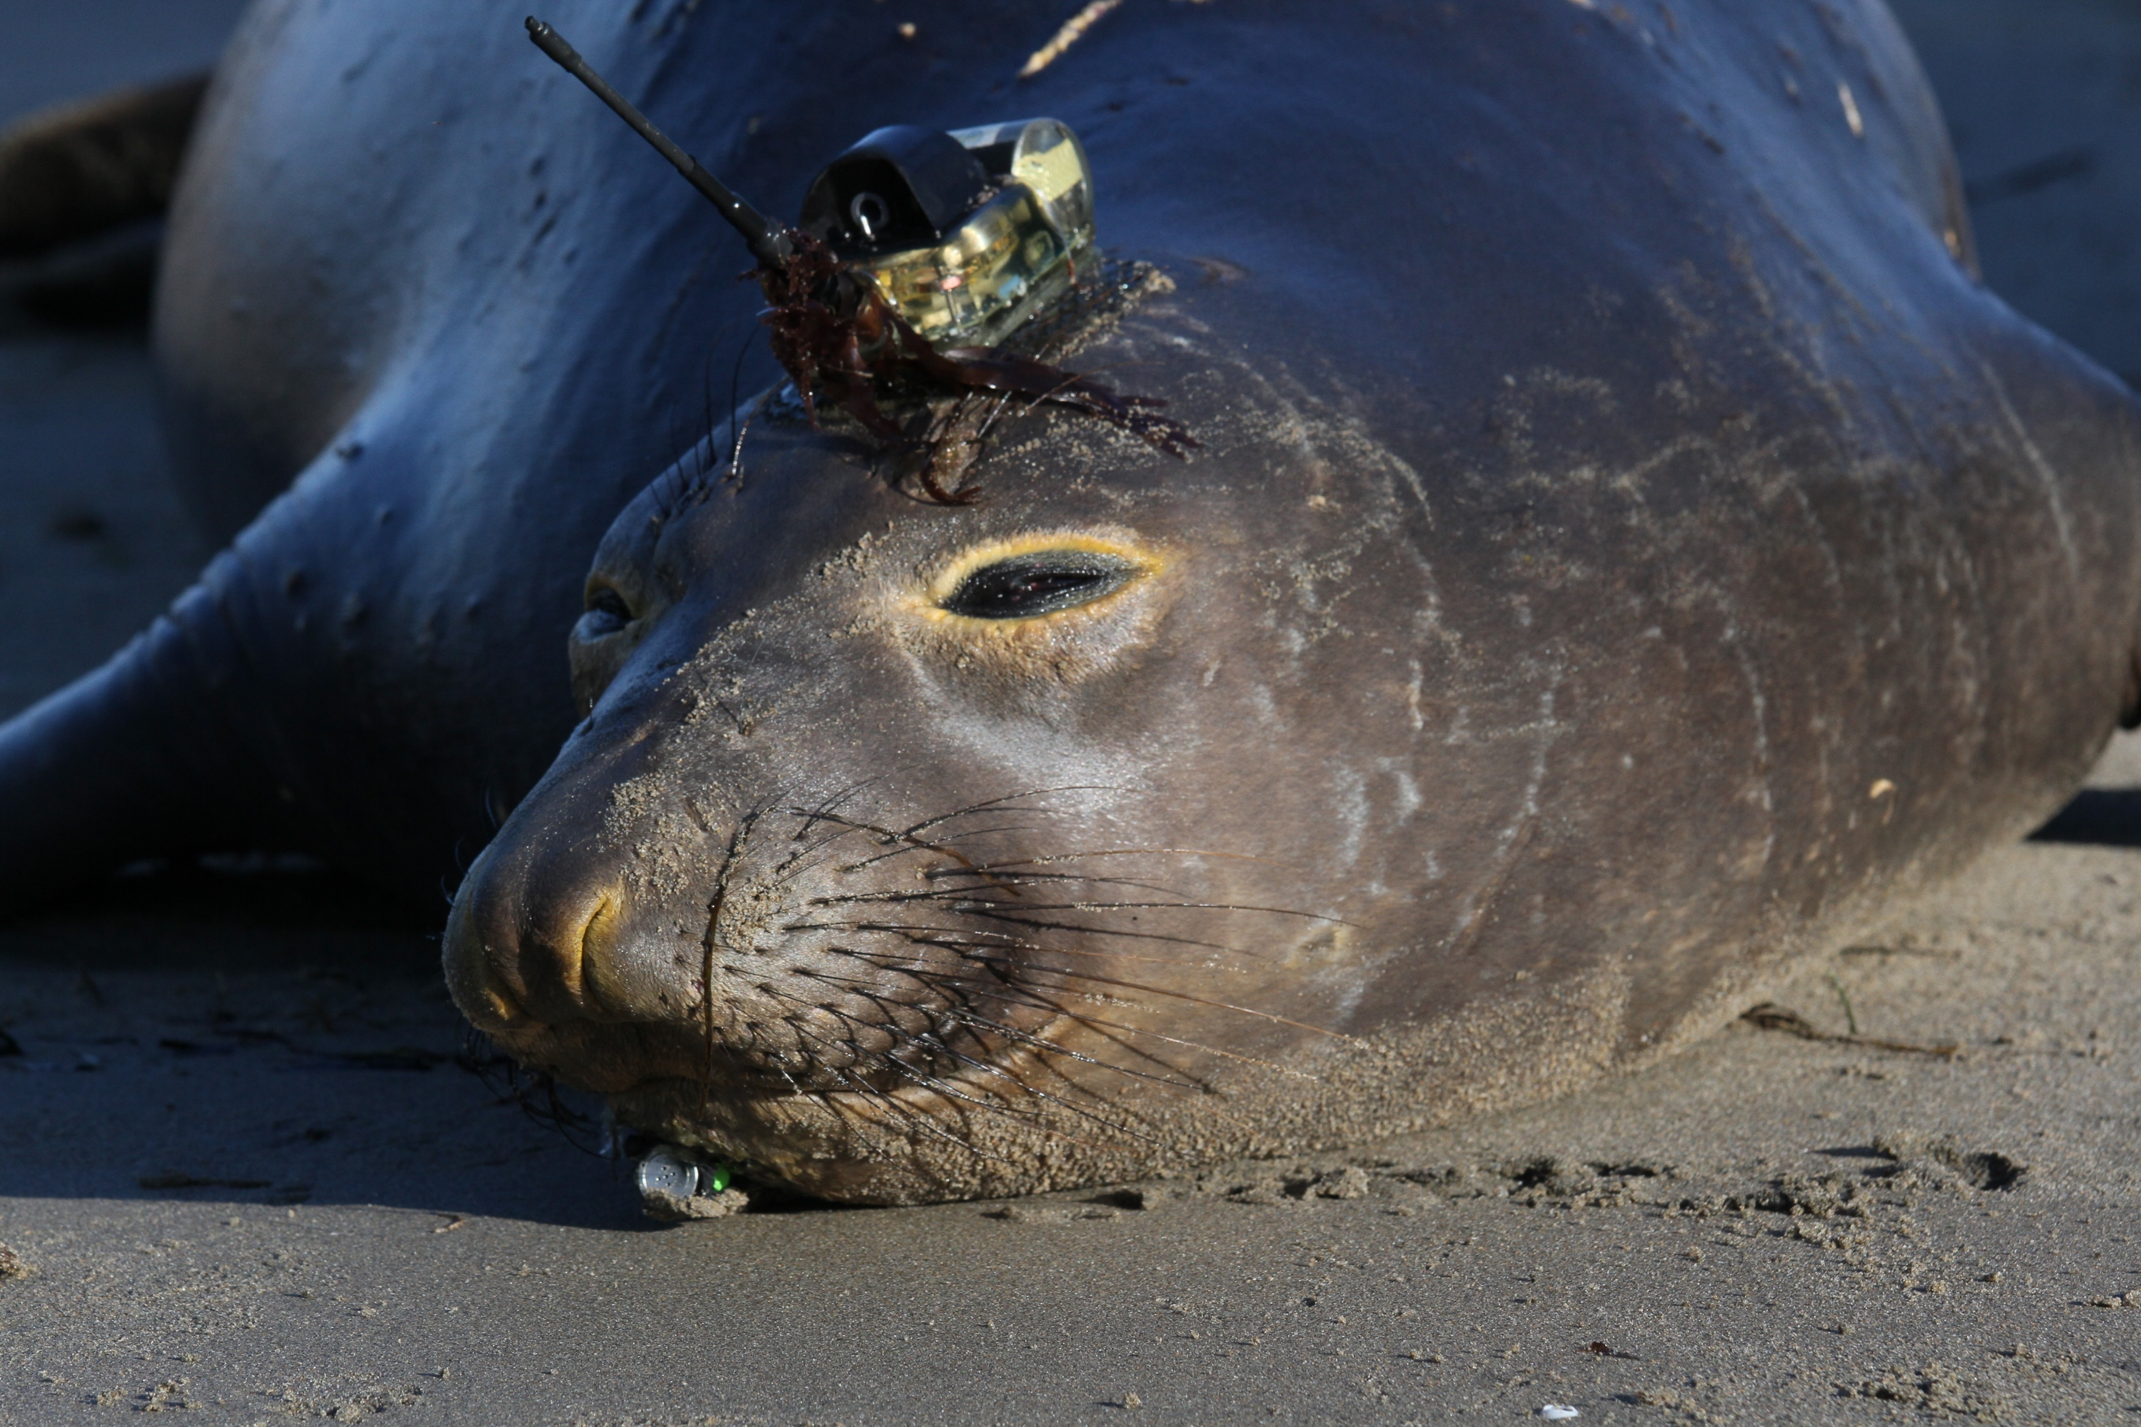
Photo: Rachel Holser
Notes:
By attaching specialized instruments to elephant seals, we can gather information about their behavior AND their habitat. This CTD tag collects high precision temperature and salinity data as the seal travels, giving us a unique look at the physical structure of the North Pacific.

Slide 13
Notes:
If we look at the tracks of last year’s seals over our original map of the Blob, you see that they travel right through the core of the anomaly. This black track happens to be a seal who carried a CTD tag, and the data she collected reveal just how deep the Blob penetrates below the surface

Slide 14
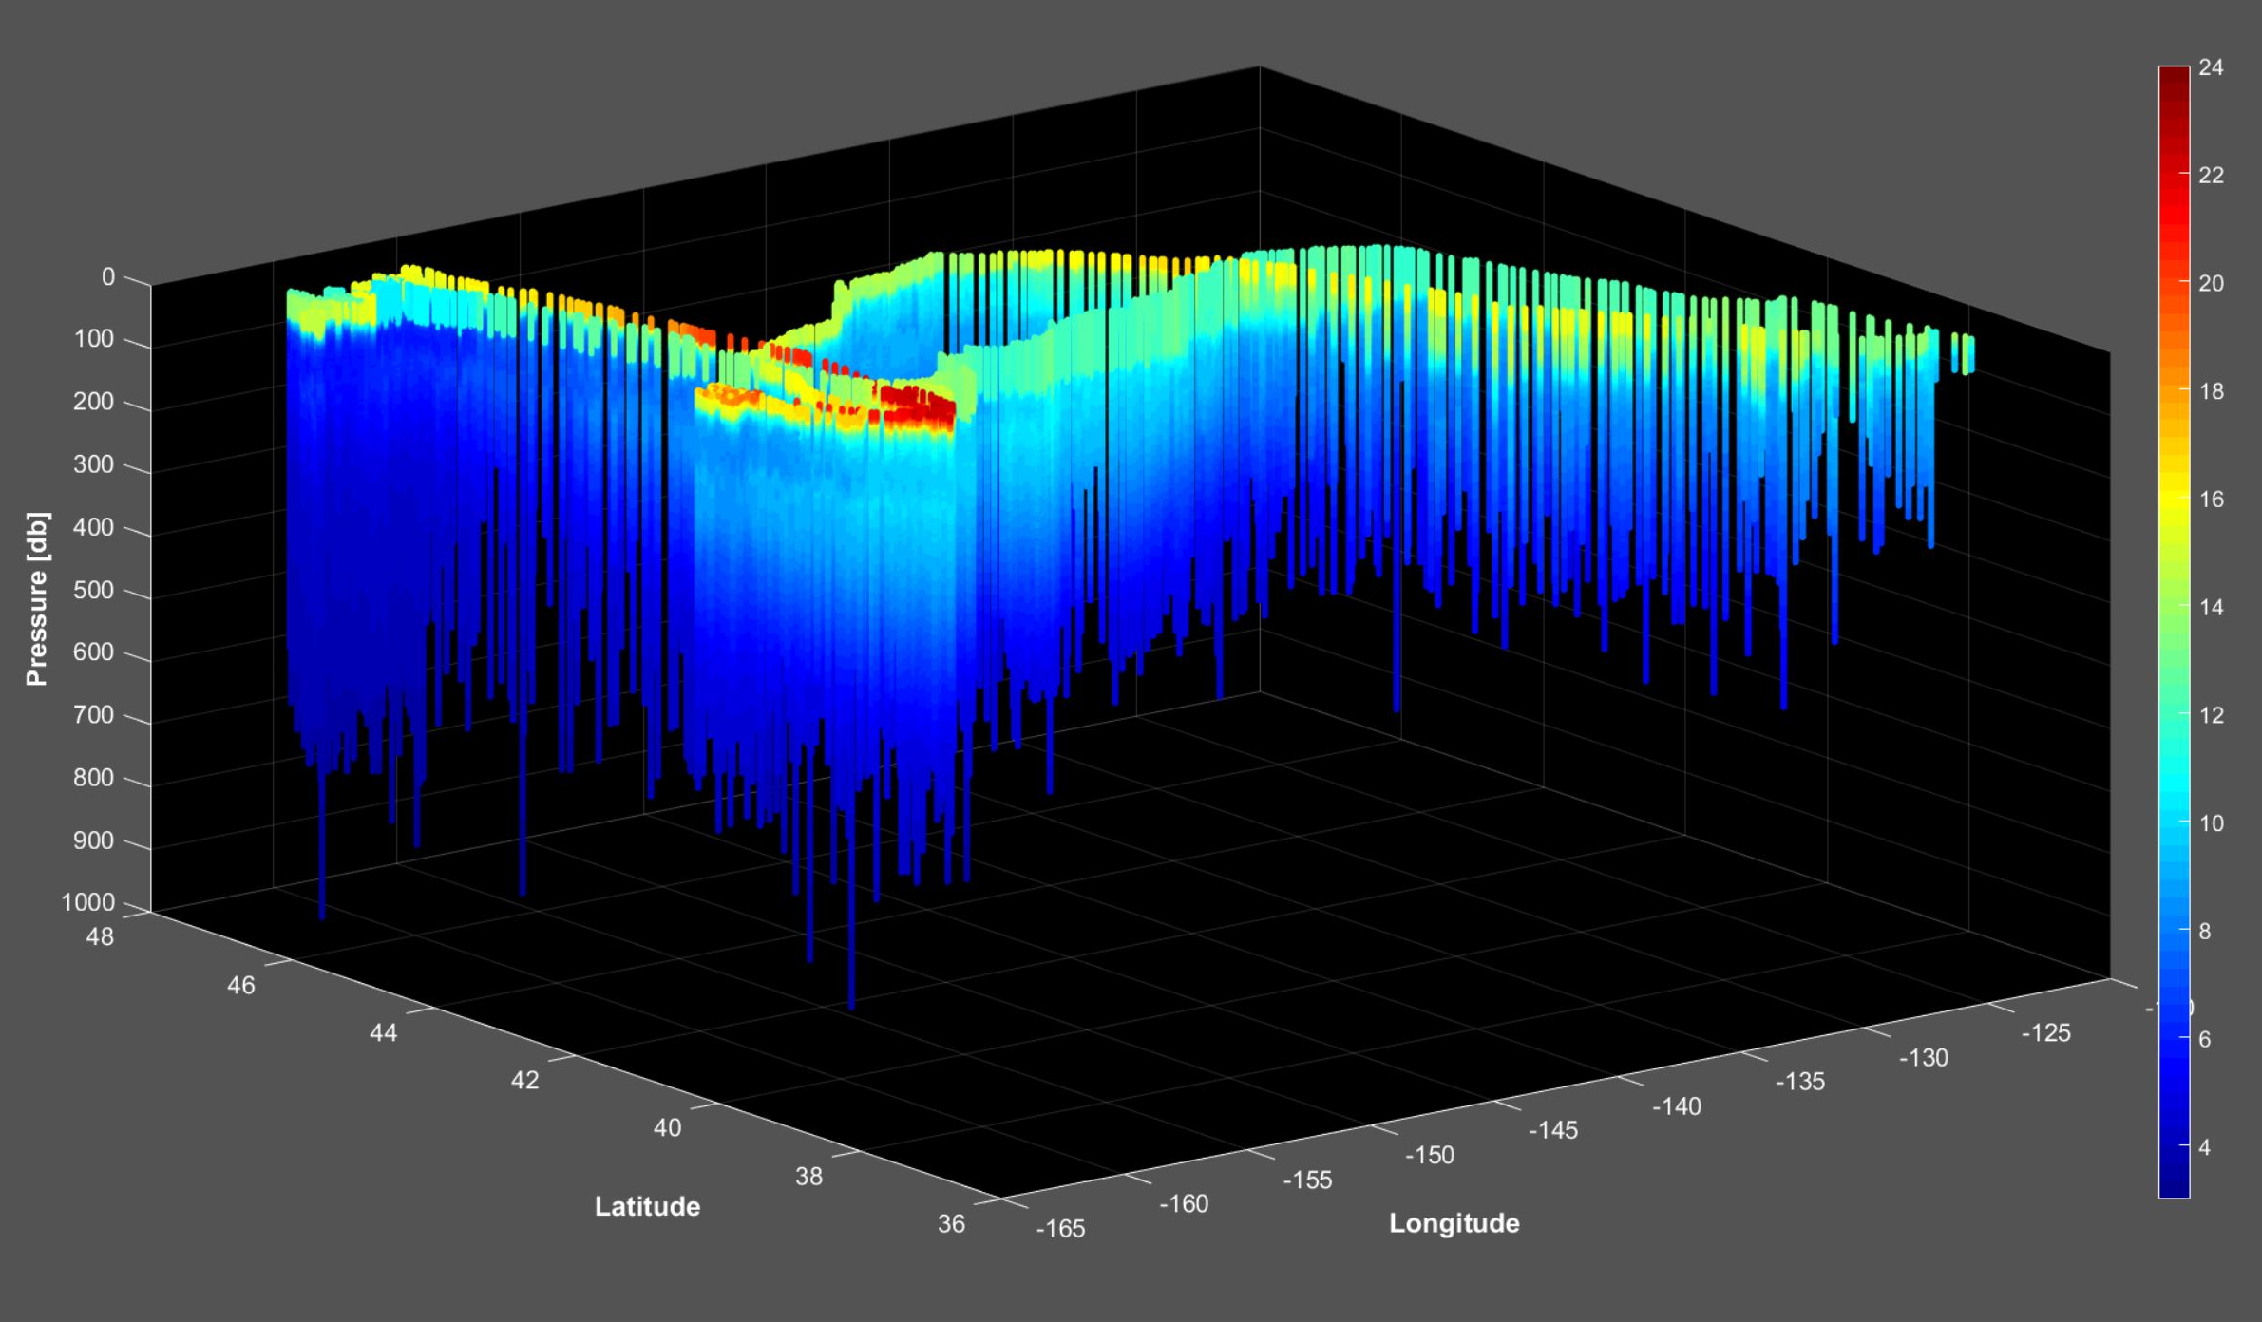
Notes:
These are temperature measurements in 3-dimensional space. You can still see the outline of her track at the top of the image in addition to the sub-surface thermal structure. Now, if we take this data and look at it in terms of time instead of space

Slide 15
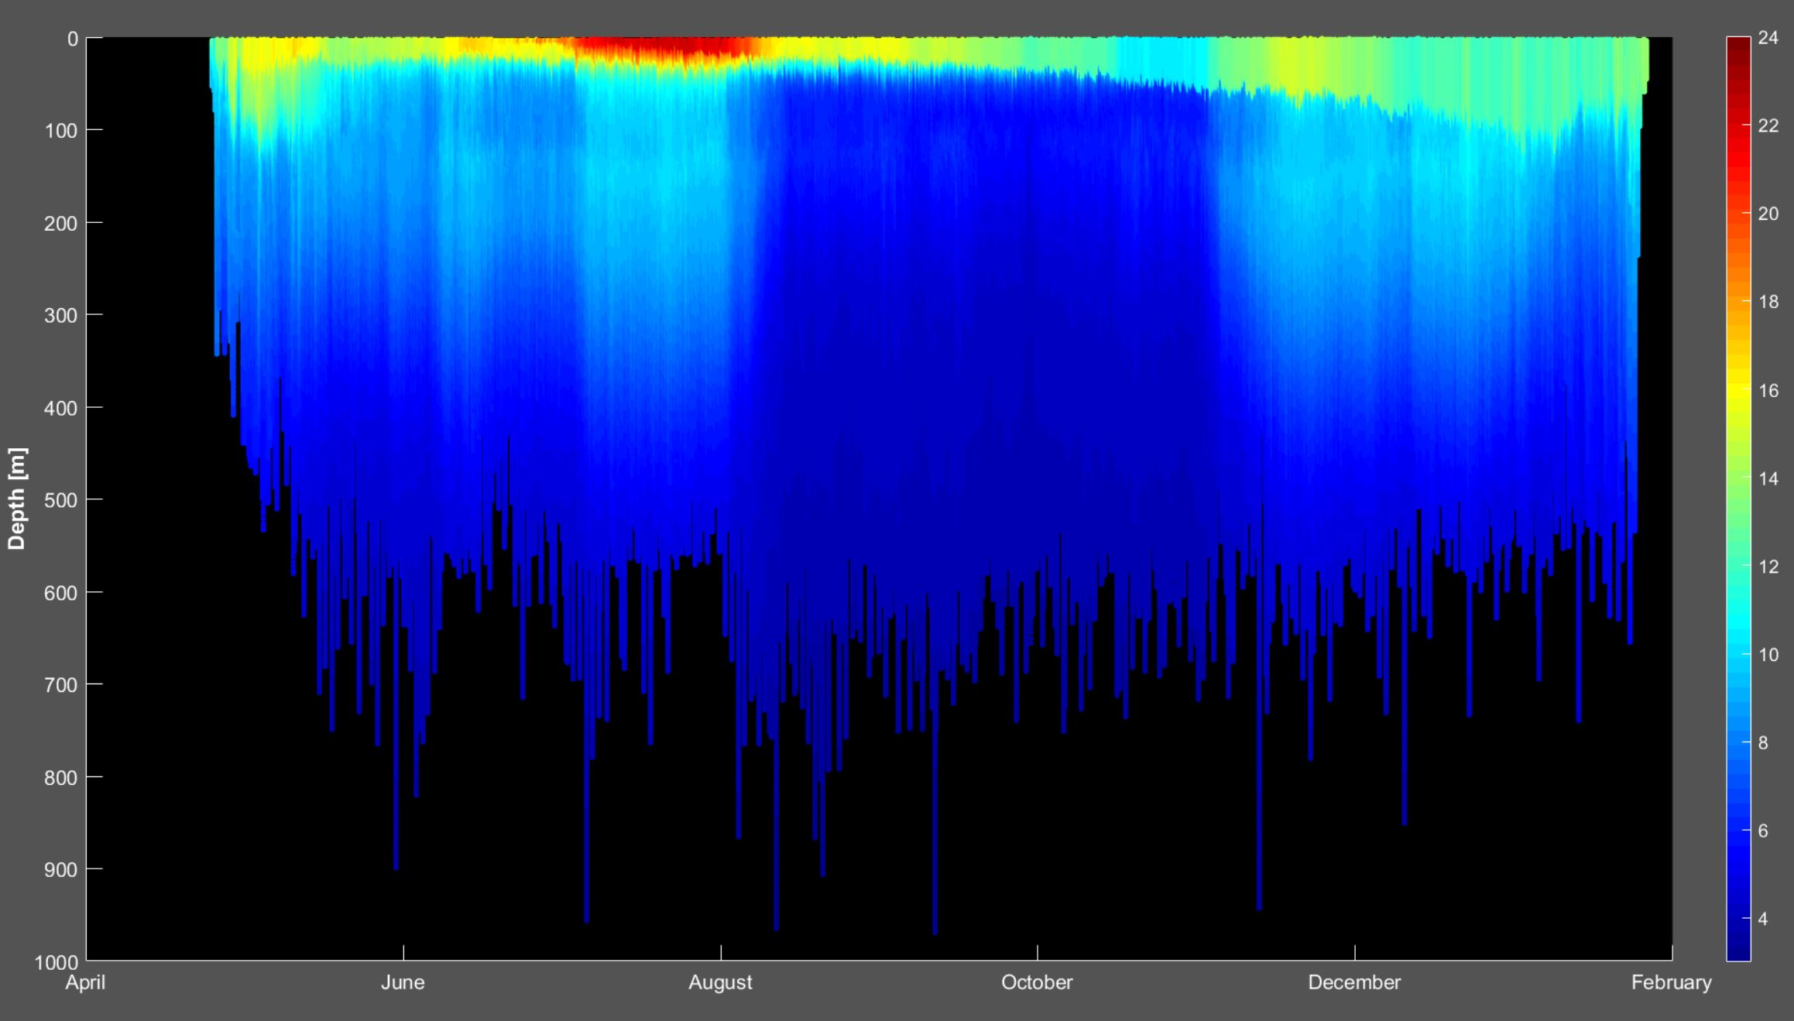
Notes:
We get a 2-dimensional image that makes it a little easier to visualize. During the month of July, this seal was in the heart of the Blob, and we can see the warmer water penetrating down to 300+ meter of depth. She chose to quickly move northward into cooler water, but temperature was not the only thing that changed.

Slide 16
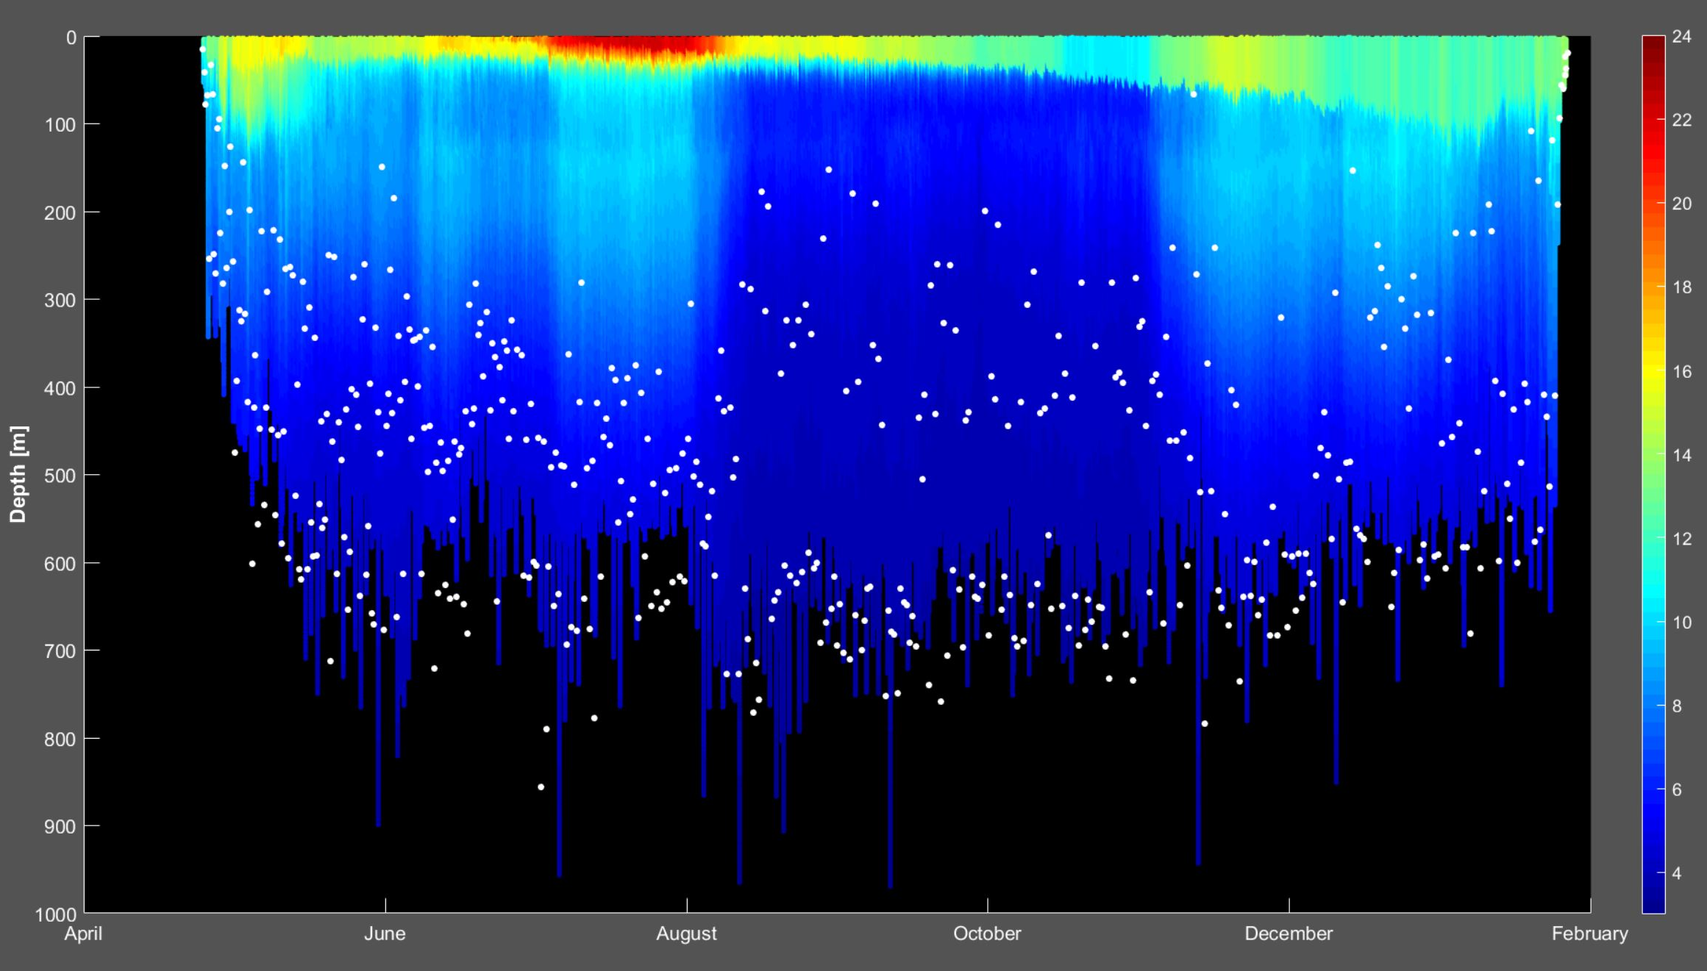


Notes:
Her diving behavior also shifted. These points each represent the bottom of a dive. Some elephant seals, including this female, exhibit a diel dive pattern. They dive deeper during daylight hours and more shallowly at night, following prey that migrate vertically in the water column.

Slide 17
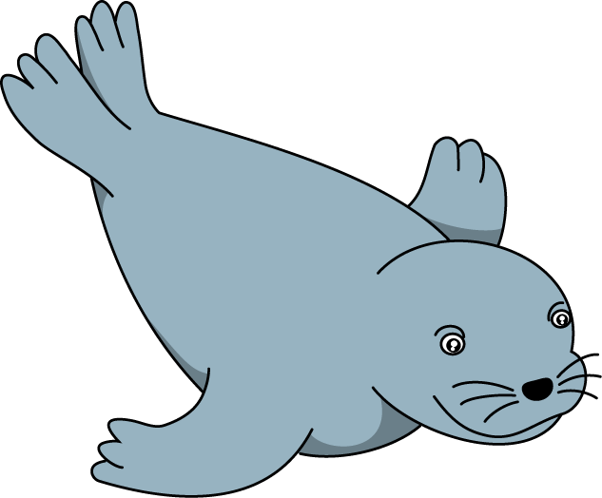
Notes:
What is particularly interesting here is that her nighttime dives became shallower as soon as she entered colder waters. There are a few possible explanations for this change…

Slide 18
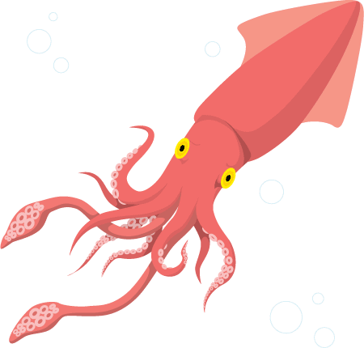
Notes:
While her prey were at a consistent depth during the day, perhaps they were trying to avoid the warmer water of the Blob and stay lower in the water column. Or perhaps she was pursuing entirely different prey species that utilized different depths at night.

Slide 19
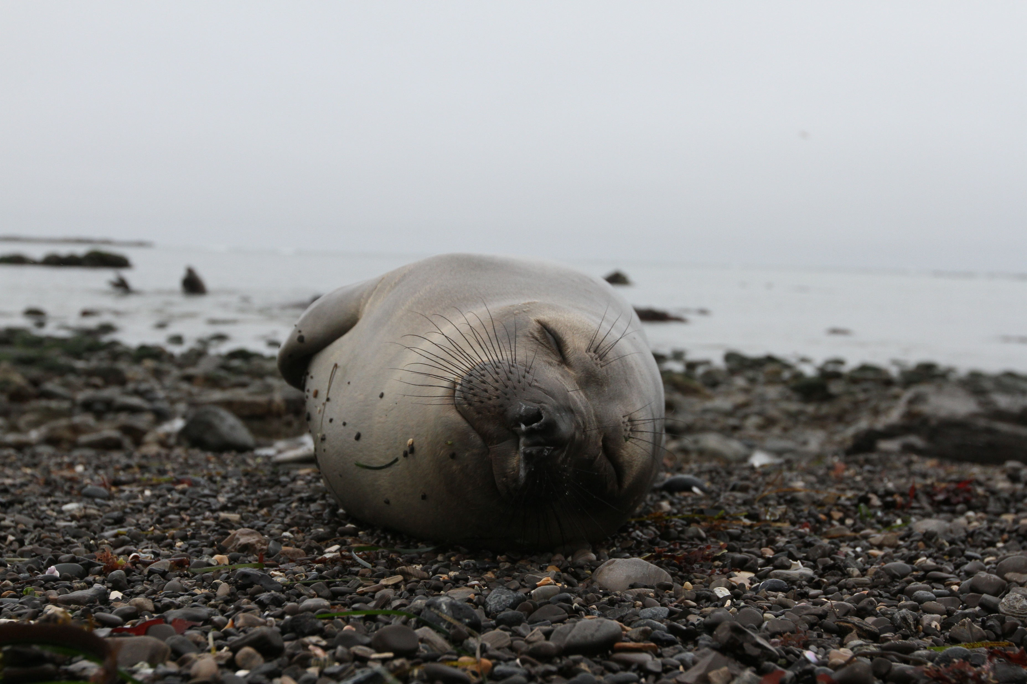
Photo: Rachel Holser
Notes:
These animals give us a window into an environment that, for us humans, is remote, foreign, and often hostile. By continuing to study them, we also better understand their habitat and the other species with which they interact. These data on the Blob are just one piece of the puzzle, and we are always learning more

Slide 20

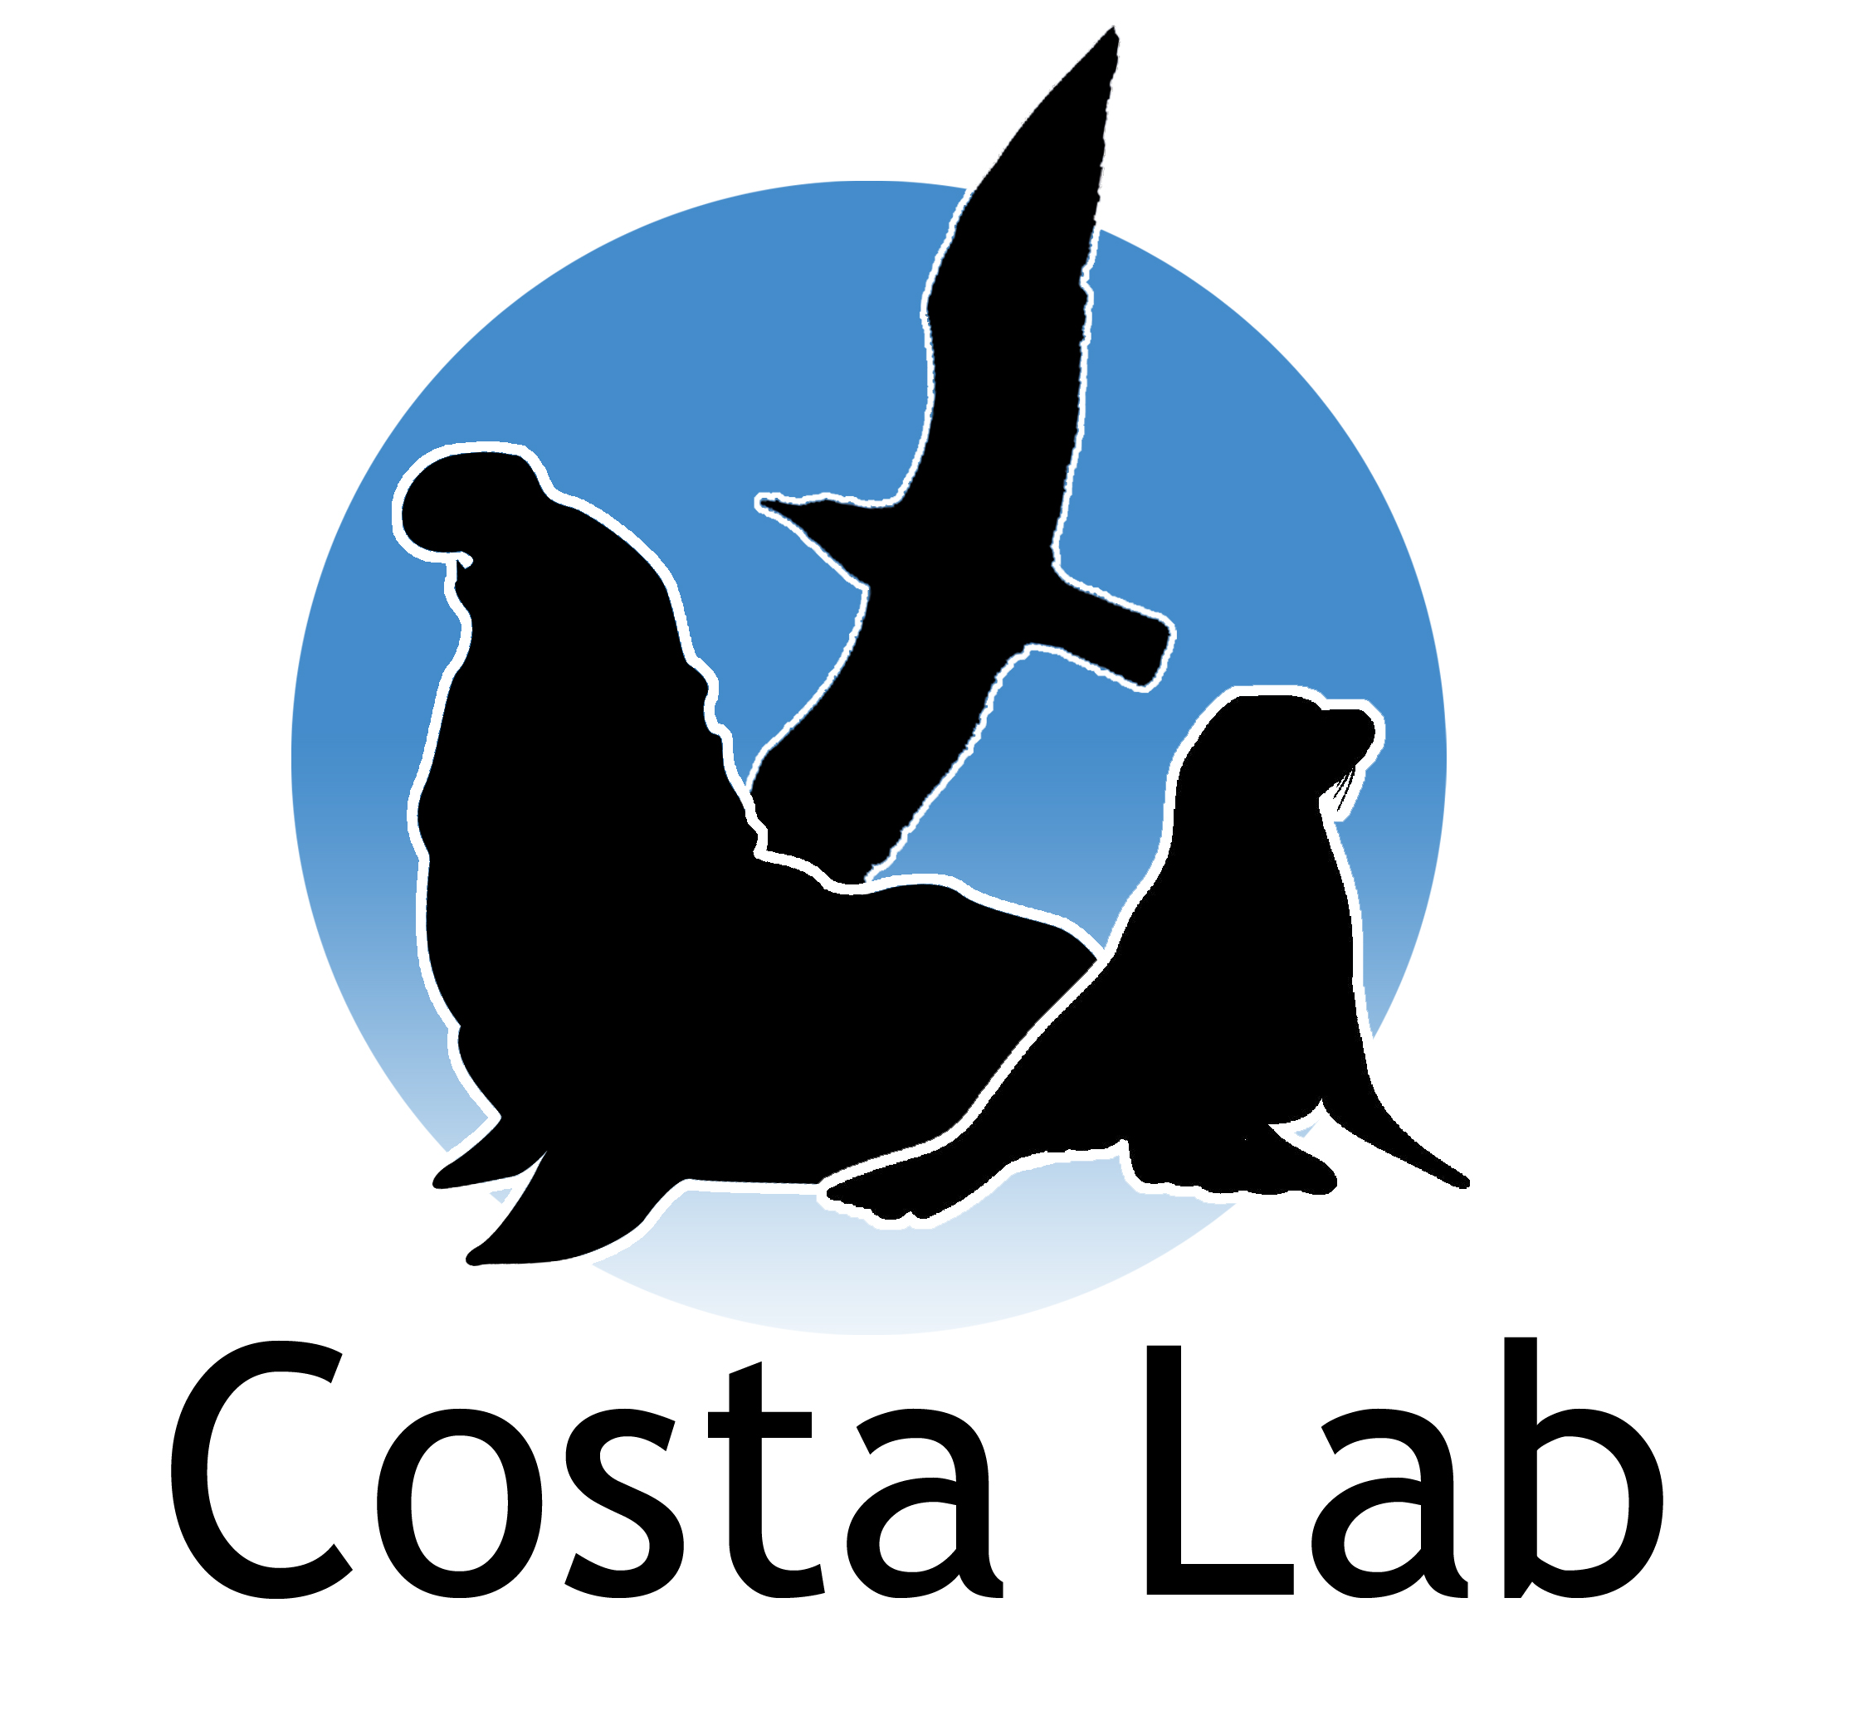



Acknowledgements
Rebecca and Steve Sooy
Dr. Daniel Costa
The Costa Lab: past, present, and future
Undergraduate volunteers
All animal handling done under NMFS Permit #19108
Notes:
In large part thanks to our supporters, and thanks to the efforts of my labmates (past present and future) and the many undergrads who come out to help us. A lot of the data you saw today was collected over multiple generations of graduate students

Slide 21
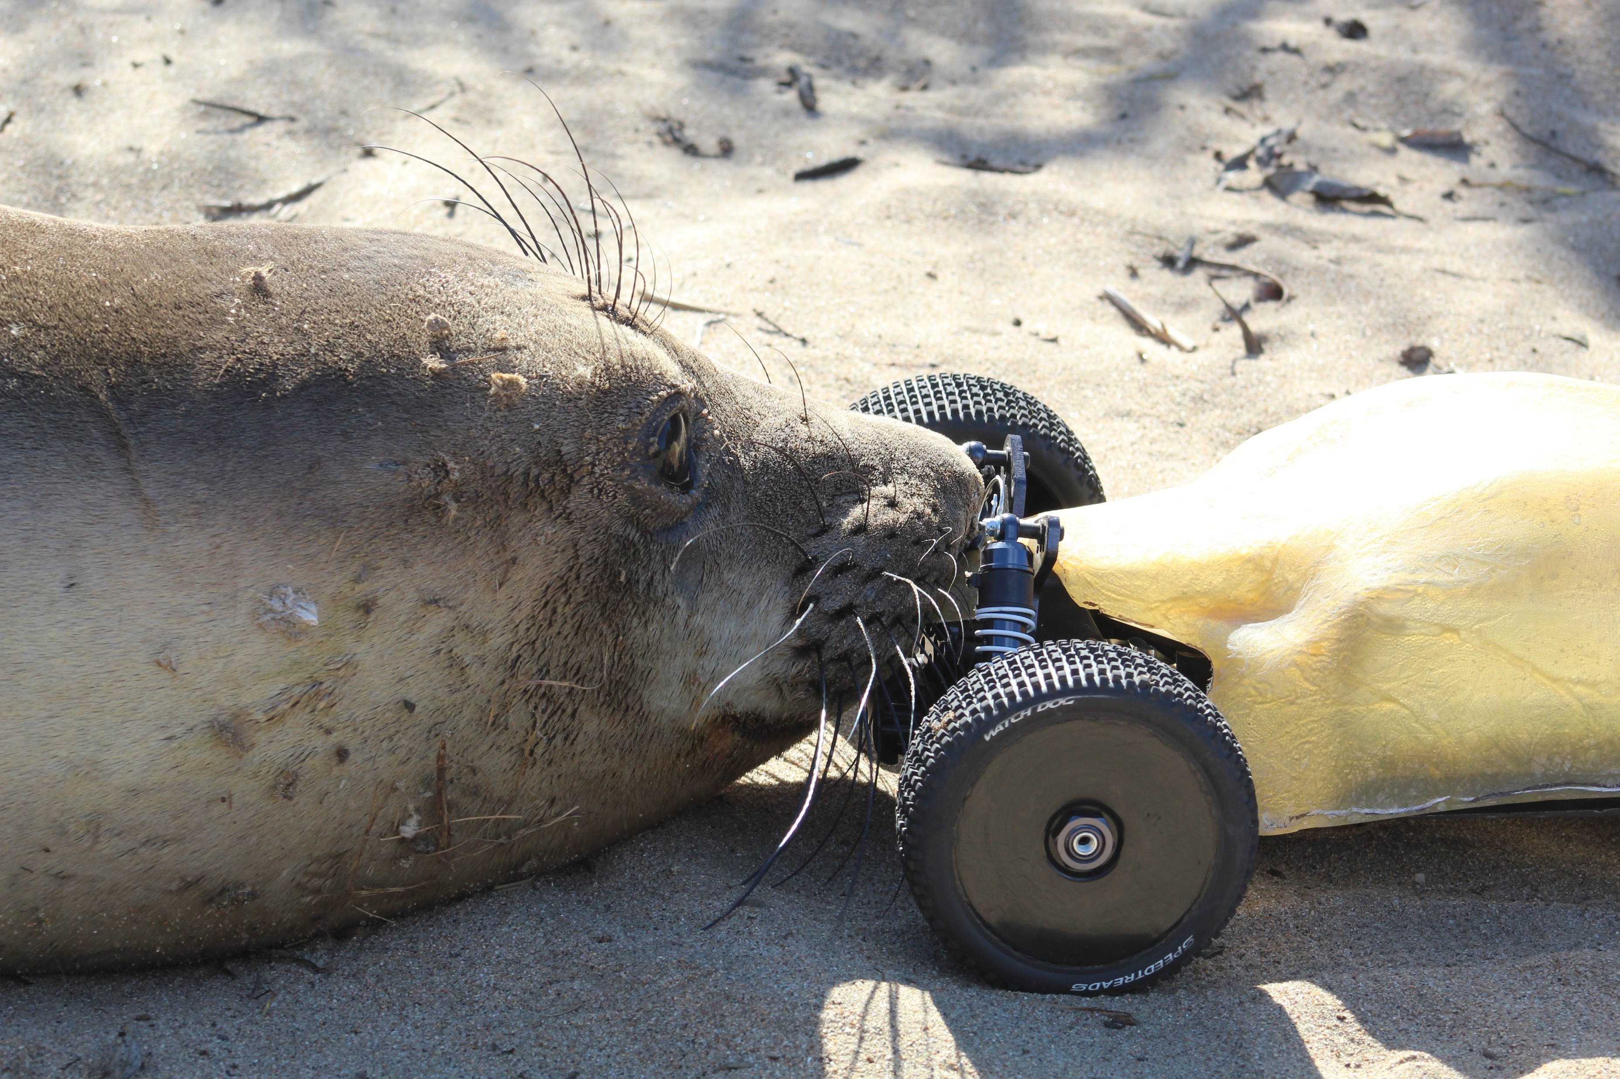
Photo: Rachel Holser

